Slide 1
Program
Part 1 – Introduction
[W01] – context changed to webgl2
Part 2 – GLSL 3.00
[W02] – Hello triangle의 shader code를 glsl 3.00 으로 바꾸기
[W03] – vertex array object
[W04] – instanced rendering
[W05] – Transform feedback and uniform array
[W06] – Textures – float, VS use, array
Part 4 – WebGL 2 Rendering – fbo, rbo
[W07] – fbo, rbo
[W08] – render to texture

Slide 2
PPT 설정 (이 슬라이드는 쇼에 안보임)
반드시 다음 2개 슬라이드를 음악과 함께 캡처해서 동영상에 포함해야 합니다.
SWTT 라이선스
소중사업 사사 문구
맨 첫 타이틀이 이상하게 나오면 아래 글꼴을 설치하세요
https://fontzone.net/font-details/ar-hermann
나눔고딕 글꼴과 D2Coding 글꼴 - https://hangeul.naver.com/font
Mac 사용자는 나눔고딕코딩 글꼴을 설치해야 할 수 있습니다.

Slide 3
Are you ready? [SPACE] to start

Slide 4




Software Tool Time

Slide 5


Slide 6
WebGL 2 Tutorial (Part 2) Textures – KTX2, float, with VS
강사
경북대학교 백낙훈 교수
아주대학교 이환용 교수
목표
WebGL 2의 새로운 texture 기능에 대해 학습
이전 Blending, Texutre에 대한 학습, float 텍스터, VS 에서 텍스처 사용
사전 준비
WebGL 1.0 튜토리얼 – YouTube https://www.youtube.com/playlist?list=PLKseYrrlvWNqmtCMZyoraXIAG2F0sG2o7
JavaScript Language 기능
로컬 Web Server 설치 – Python 설치 권장
KTX tool - https://github.com/KhronosGroup/KTX-Software

Slide 7
Review WebGL 1 and texture
WebGL 1 Tutorial 11 – Texture 와 Blending, Z-Buffer의 복습

Slide 8
W06a: T11을 WebGL 2
chatGPT를 사용하여 변경
gl-matrix 라이브러리의 일부 유용한 기능을 사용하기 위해 유지

Slide 9
W06c texture in VS
`#version 300 es
in vec4 myVertex;
in vec4 myColor;
in vec2 myUV;
uniform mat4 mMat;
uniform mat4 vMat;
uniform mat4 pMat;
uniform sampler2D tex2;
out vec4 col;
out vec2 uv;
void main(void) {
vec4 texColor = texture(tex2, myUV);
vec3 offset = texColor.rgb * 0.5;
vec4 newVertex = myVertex + vec4(offset, 0.0);
gl_Position = pMat * vMat * mMat * newVertex;
gl_PointSize = 8.0;
col = myColor;
uv = myUV;
}`
Change Cube faces into 10x10 grid
with help of AI chat
Divide two triangles into 10x10 triangles
Change vertex position with texture RGB

Slide 10
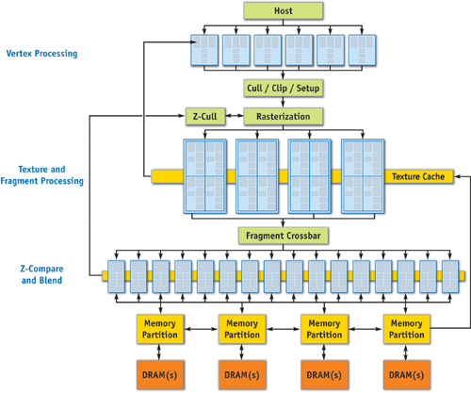
NVIDIA GeForce 6 GPU Architecture

Slide 11
WebGL 2 texture features
WebGL 2 can use texture size is not power of 2
WebGL 2 can use texture in VS
WebGL 2 can use textures array
WebGL 2 can use textures with 32bit float and others.
WebGL 2 can use compressed image KTX2

Slide 12
W06b : WebGL 2 texture at VS
Texture can be used for change vertex position, normal, color, etc.

Slide 13
W06c : WebGL 2 texture array and 3D texture
Texture can be used array form
3D Textures

Slide 14
W06d : WebGL 2 texture KTX2 and floating point texture
How to make floating point textures and KTX2
How to use in WebGL 2

Slide 15
KTX2 Parse
Only PNG and JPG can be loaded with "image" elements
Need loader and parser parser
Node.js – KTX Parser package
Parsor in Three.js module

Slide 16
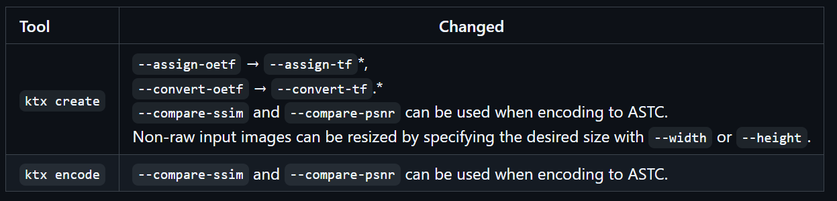
KTX2 image tools
install tools
https://github.com/KhronosGroup/KTX-Software/releases Or
https://developer.nvidia.com/texture-tools-exporter

Slide 17
KTX Supports by GPU and Browsers
Checking code
GPU supports and Web Browser supports
Code : KTX_check.html
Result of (NVIDIA + Chrome)
KTX2 Support Check
{
"webgl2": true,
"ktx2_uncompressed": true,
"astc": false,
"s3tc": true,
"etc": false,
"etc1": false
}

Slide 18
floating point texture
WebGL 2 can use 32 bit floating point pixel (for R,G, B, A)
can used for HDR (High Dynamic Range)
Create HDR image with Photoshop filter
Save 32bit float image with format EXR
convert to KTX2

Slide 19
Software Tool Time (소프트웨어 툴 타임)
(CC-BY-NC 4.0) KNU and Ajou Univ.
Visit “Software Tool Time” channel in YouTube : https://www.youtube.com/c/SoftwareToolTime
All product names, trademarks, and/or company names are used solely for identification and belong to their respective owners.
“Software Tool Time” video is licensed to the public under a Creative Commons Attribution 4.0 License (https://creativecommons.org/license/by/4.0/)
Twin Musicom’s African Drums (Sting) is licensed to the to the public under a Creative Commons Attribution 4.0 License (Artist: http://www.twinmusicom.org/)

Slide 21

본 영상은 2021,2022년도 과학기술정보통신부 및 정보통신기획평가원에서 지원하는 SW중심대학사업의 결과물 입니다.
본 영상의 내용을 전재할 수 없으며, 인용할 때에는 반드시 과학기술정보통신부와 정보통신기획평가원의 'SW중심대학사업'의 결과물이라는 출처를 밝혀야 합니다.

